Slide 1

Writing a Class (Animating Multiple Objects)
Develop a Sprite Class

Slide 2
Learning Objectives
Last Weeks
Class – template for an object, description of variables
Object – Variable with compartments - members
Methods – functions (procedures) how to use the class
Constructor – special method called on NEW command
Parameters – passing values to methods
This Weeks Objectives
Develop a Class
Animate an object
More methods

Slide 3
Revision : Using Our Class
class Sprite {
float x;
float y;
float dx;
float dy;
}
Sprite box, ball;
void setup()
{
box = new Sprite();
ball = new Sprite();
}
Calling
mySprite = new Sprite();
creates a new object that contains its own x, y, dx, and dy values.
We can set them like this:
ball.x = 10; // initialize ball
ball.y = 10;
ball.dx = 1;
ball.dy = 1.5;
box.x = 450; // initialize box
box.y = 450;
box.dx = -1.5;
box.dy = -1;
Class description
Declare Variables
Type : Sprite
Create instances

Slide 4

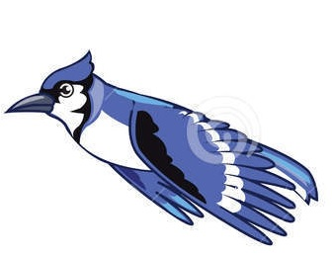

Problem : flying birds
What information to animate a bird flying around screen?
Easy
x, y, speedX, speedY
Harder
Picture, changing picture in a sequence (image1, image2, image3, image2, image1…)
Top down design
Clear background
Draw current image
Move image right
Cycle Current image through sequence

Slide 5
Adding Images to Class Bird
PImage - Built in Class to allow us to load and display image files
Has members including: float width, height
Has methods including void resize(width, height);
Can create instances of PImage and load image files Into each
PImage image1 = loadImage(“bird1.jpg");
imageMode(CENTRE); // x,y to be centre
image(image1,x,y); command displays image1 at x,y

Slide 6
Bird members
class Bird
{
int x; //changes position
int y; //constant value
int speedX, speedY;
PImage image1,image2, image3; //member : instance of a class
}
What methods do we need?

Slide 7
Bird Methods
What should a Bird be able to do?
Moves around screen [up,down,left,right] (cycles through images)
Move
Display (render)
A constructor?
What information to setup a new bird?
Where is it?
How fast – x direction, y direction?

Slide 8
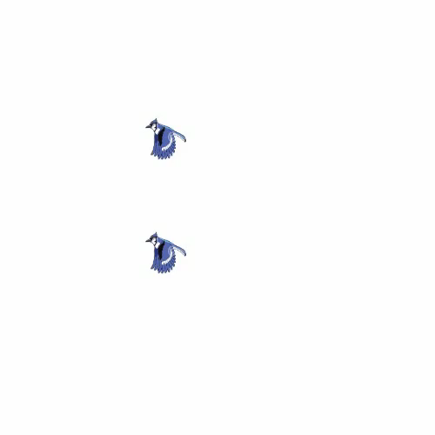
Methods – top down design
Move (easy – same as bouncing ball)
Add speedX to x location
Add speedY to y location
Detect bounces of edges?
Render (top down)
Select next image in sequence
Draw image at x,y
Too fast – changes picture every 60th sec!, messy
Select next image in sequence
If (currentImage is image1)
currentImage is image2
Else if (currentImage is image2)
currentImage is image3
…
Draw currentImage
What effect – draw repeated 60x sec
Messy sometimes going forward, then
back

Slide 9
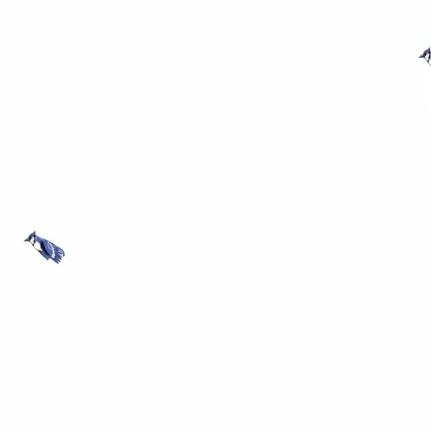
Cycle through images
Too quick – better to show the same image for n frames
E.g. 10 frames for each image – how?
Introduce a counter
Pseudocode?
Don’t need currentImage
Counter determines where in sequence.
Where would we declare Counter?
What about when image3
Cycle Current image through sequence
If (counter >=0 && counter <=10)
draw image1
Else if (counter >10 && counter <=20)
draw image2
…
Else
countDir= -countDir; //reverse sequence
counter = counter+countDir; //+1 or -1

Slide 10
Move Method
class Bird {
int x;
int y;
int speedX, speedY;
int counter = 0;
int countDir=1;
PImage image1,image2,image3;
void move()
{
x = x+speedX;
y = y+speedY;
}
improved
void render()
{
imageMode(CENTRE);
if (counter>=0 && counter<=5){
image(image1,x,y);
}
else if (counter>5 && counter<=15){
image(image2,x,y);
}
else if (counter>15 && counter<=25)
{
image(image3,x,y);
}
else
{
countDir = -countDir; //reverse sequence
}
counter = counter + countDir;
}

Slide 11
Bird Constructor
class Bird {
int x;
int y;
int speedX, speedY;
int counter = 0;
int countDir=1;
PImage image1,image2,image3;
Bird (int x, int y, int dx, int dy)
{
this.x = x;
this.y = y;
this.speedX=dx;
this.speedY = dy;
image1 = loadImage("bird1.jpg");
image2 = loadImage("bird2.jpg");
image3 = loadImage("bird3.jpg");
}
What information to setup a new Bird?
Where is it?
How fast – left to right?
Top down – pseudocode
Set x
Set y
Set speed (x axis, y axis)
Load pictures- sequence
Perhaps resize images
Could improve

Slide 12
Using the class
Bird polly, bluey;
void setup()
{
size(500,500);
polly = new Bird(500,100,-3,2);
bluey= new Bird(500,150,-5,-5);
}
void draw()
{
background(255);
polly.render();
polly.move();
bluey.render();
bluey.move();
}
Lets set up 2 flying birds
Different directions
Top down design (for 1 Bird)
Clear background
Draw current image
Move image right
Cycle Current image through sequence
Refactor?

Slide 13
Refactor
Bird polly, bluey;
void draw()
{
background(255);
polly.update();
bluey.update();
}
Bird always has render then move
Could introduce a new method with these steps
void update()
{
render();
move();
}

Slide 14
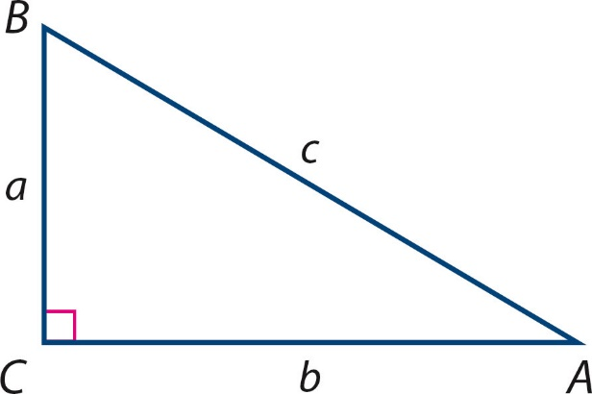
Collision – proximity detection
Collision detection can be handled by measuring the distance between two on-screen objects
Simplified as : if x locations are within a threshold AND y locations are within a threshold then a collision is detected
Lets write a collision method for Bird – detect whether another bird is too close
Method procedure or function method – i.e. return void or ?
(this.x,this.y)
Pythagoras
sqrt((this.x-other.x)² + (this.y-other.y) ²)
(other.x,other.y)

Slide 15
Collision method
Function : True or false – Boolean
If we were detecting collisions with another Bird
What parameters – if any?
Bird
Add to Bird class
boolean crash(Bird other)
{
return (abs(this.x-other.x) < 10 && abs(this.y-other.y) < 10);
}
Called with if (polly.crash(bluey))

